Slide 1
JUDGE FROG
COMPREHENSIVE HUMAN TRAFFICKING DATA
SEARCH AND ANALYSIS
Brice Boula, Collin Duncan,
David Tomlinson, Landon Westrom
TCU Computer Science
Senior Capstone Project 2014-2015
Final Presentation

Slide 2
Human Trafficking Facts
One of the most profitable criminal activities worldwide
600 to 800 thousand people across international borders annually
80% female
50% children
Gross violation of human rights
Need for studies to understand and address problem

Slide 3
Background
NIJ grant awarded to TCU professor
Goals of grant for project
Publicly available centralized database of HT data
Support study for government, NGOs, researchers
Professor approached TCU CS of summer 2014
Student project possibilities
Selected as 1 of 3 senior capstone projects

Slide 4
Topics
Project Requirements
Development Process
System Overview
Database Structure
Technologies Used
Web Application
Results/Challenges/Conclusion

Slide 5
Project Requirements
Create database for trafficking data
Web application to interface with database
Extensive search capabilities
Analyze data with charts
Provide data management for client

Slide 6
Fall 2014 Semester
Project Defined
Initial Meetings with Clients
Early Versions of Documentation
Project Plan
Project Requirements
Iteration 1
Database design
Web application skeleton
Search prototype

Slide 7
Spring 2015 Semester
Iteration 2
Website design finalized
Search functionality completed
Analyze prototype
Iteration 3
Analyze functionality completed
Admin panel prototype
Iteration 4
Admin panel completed
Web application completed
Finish testing and documentation

Slide 8
System Overview

Slide 9
Data Flow
Admin Control Panel
Single Insert
Review
Edit
Batch Upload
Download
Admin
Data In Progress
Data
User Application
Search
Analyze
User

Slide 10
Database
Developed using MySQL5
MySQL Workbench
Stores denormalized case information
Conforms to client standard

Slide 11
Database
Case
Judge
Victims
Defendant
Organized Crime Involvement
Arrest Details
Charge Details
Sentencing Details
Variable Name | Type
Name | VARCHAR
Number | VARCHAR
Number of Defendants | INT
State | VARCHAR
Federal District Location | VARCHAR
Federal District Number | INT
Summary | TEXT
Type | INT
Variable Name | Type
Name | VARCHAR
Gender | BOOLEAN
Race | INT
Tenure | YEAR
Appointed By | BOOLEAN
Variable Name | Type
Total | INT
Female | INT
Foreign | INT
Minor | INT
Variable Name | Type
First Name | VARCHAR
Last Name | VARCHAR
Alias | TEXT
Gender | BOOLEAN
Race | INT
Birthdate | YEAR
Arrest Age | INT
Variable Name | Type
Name | VARCHAR
Race | INT
Scope | INT
Size | INT
Variable Name | Type
Date of Arrest | DATE
Detained | BOOLEAN
Bail Type | INT
Bail Amount | INT
Variable Name | Type
Date of Charge | DATE
# Felonies Charged | INT
Counts per Statute | INT
Pleas per Statute | INT
Trials per Statute | INT
Fines per Statute | INT
Sentencing per Statute | INT
Probation per Statute | INT
Variable Name | Type
Date of Sentence | DATE
Date of Sentence Termination | DATE
# Felonies Sentenced | INT
# Months Sentenced | INT
Restitution | INT
Asset Forfeiture | BOOLEAN
# Months Probation | INT

Slide 12
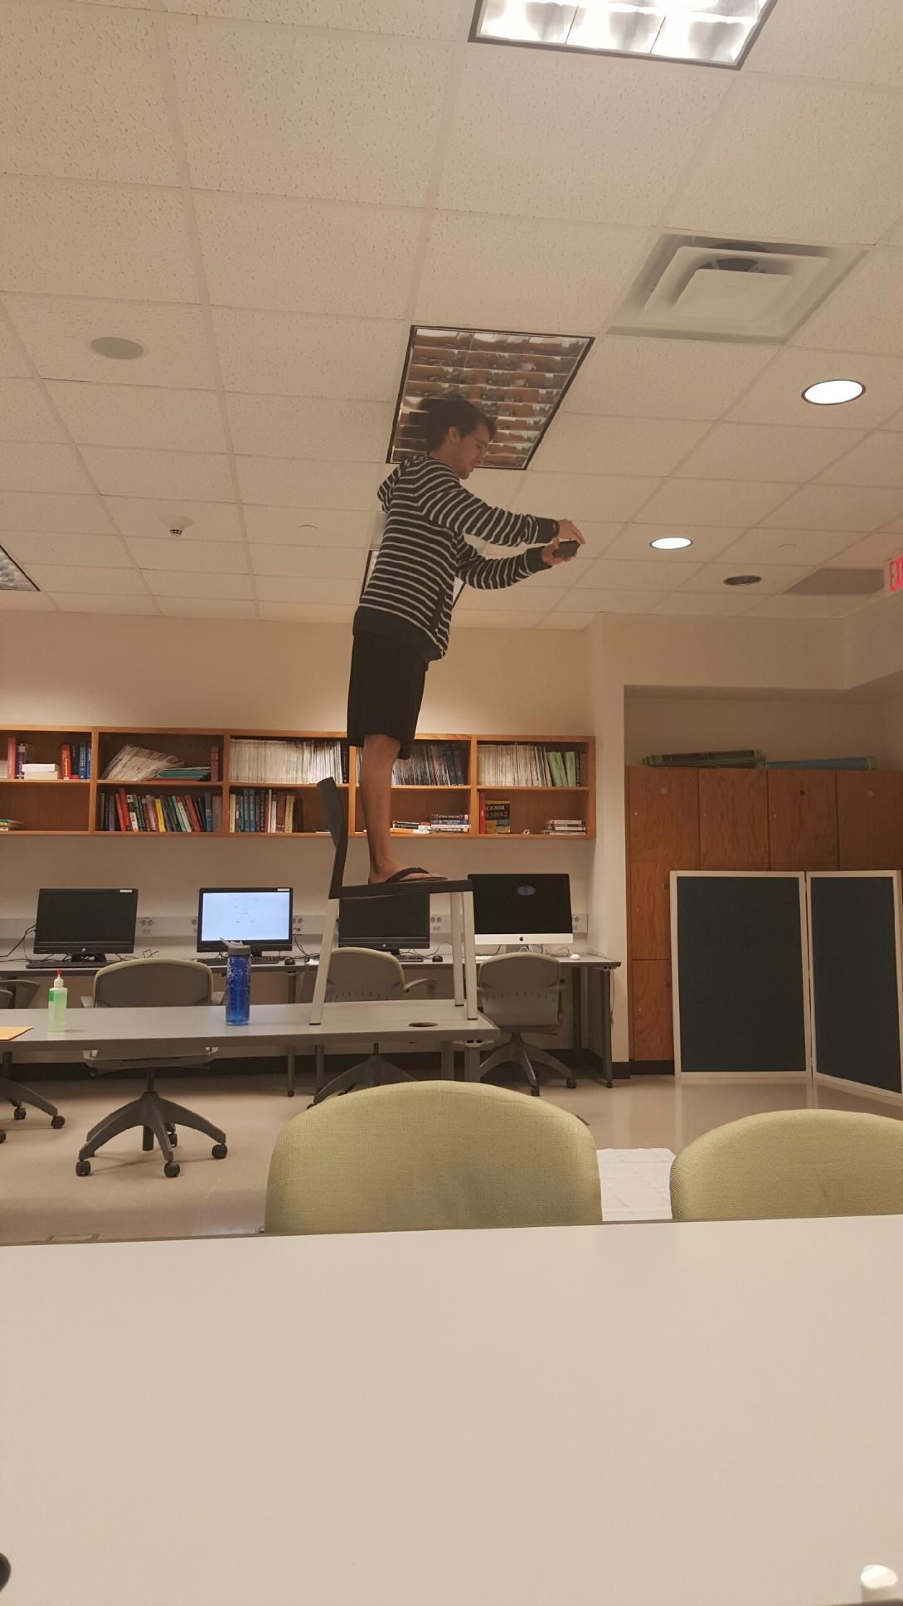
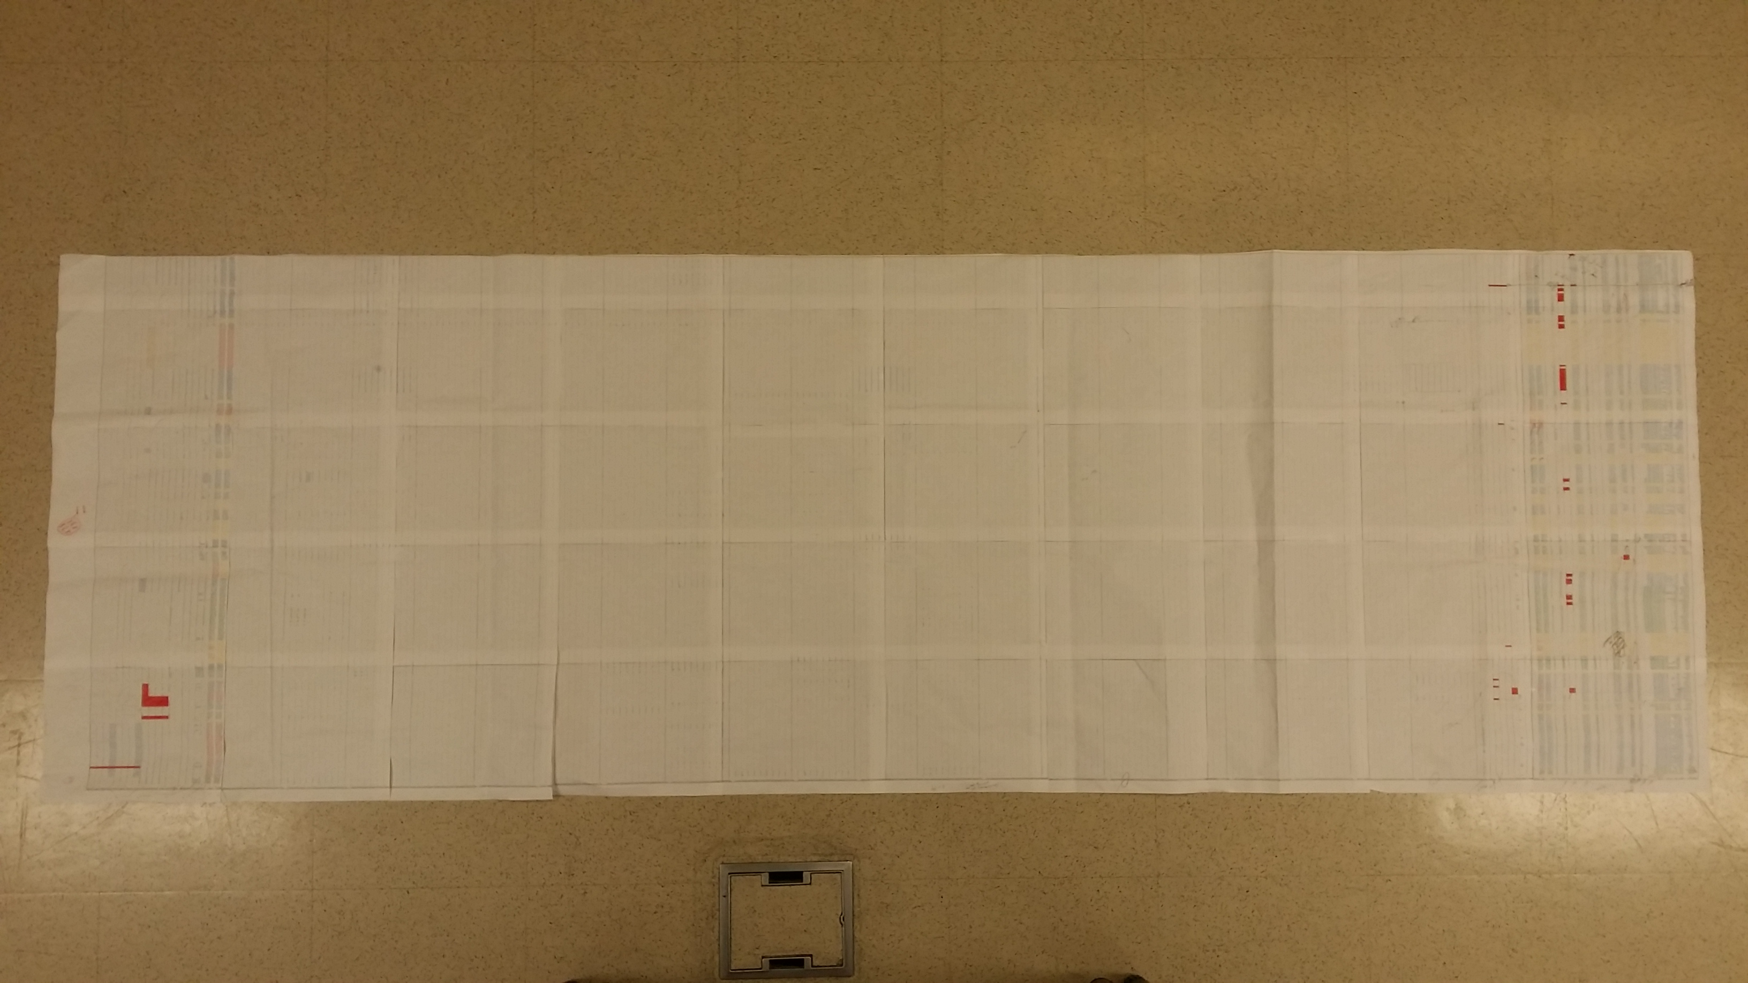
Database
5pt font
7ft long
50 sheets of paper
1 roll of tape
1 table
1 chair
1 professor leaving the room

Slide 13
Why MySQL?
Scalability, flexibility, and performance
Availability from web hosting providers
MySQL Workbench

Slide 14
Web Application
Developed using:
PHP
CakePHP Framework
Javascript + JQuery
Google Charts
Bootstrap
Comprised of three sections

Slide 15

Why PHP/CakePHP?
PHP
Popular
Flexible
MySQL
Available for Windows and *nix
CakePHP
MVC framework
Simple configuration
Built-in securities

Slide 16
Web Application
Admin Panel
Search
Analyze
maintains
refines
visualizes

Slide 17
Admin Panel
Maintain database and users
Two classes of users:
Admin: full permissions
Research Assistant (RA): insert/edit permissions
Case insertion
Single-case
Batch upload (admin only)
Case review
Administrators verify inserted/updated data

Slide 18
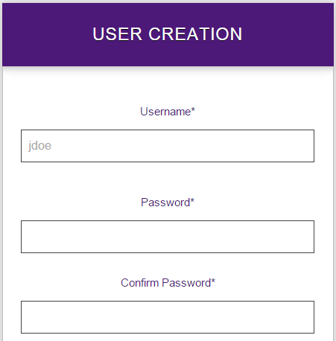
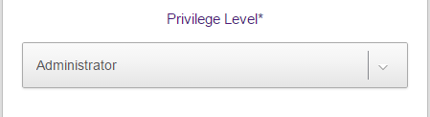
User Management

Slide 19
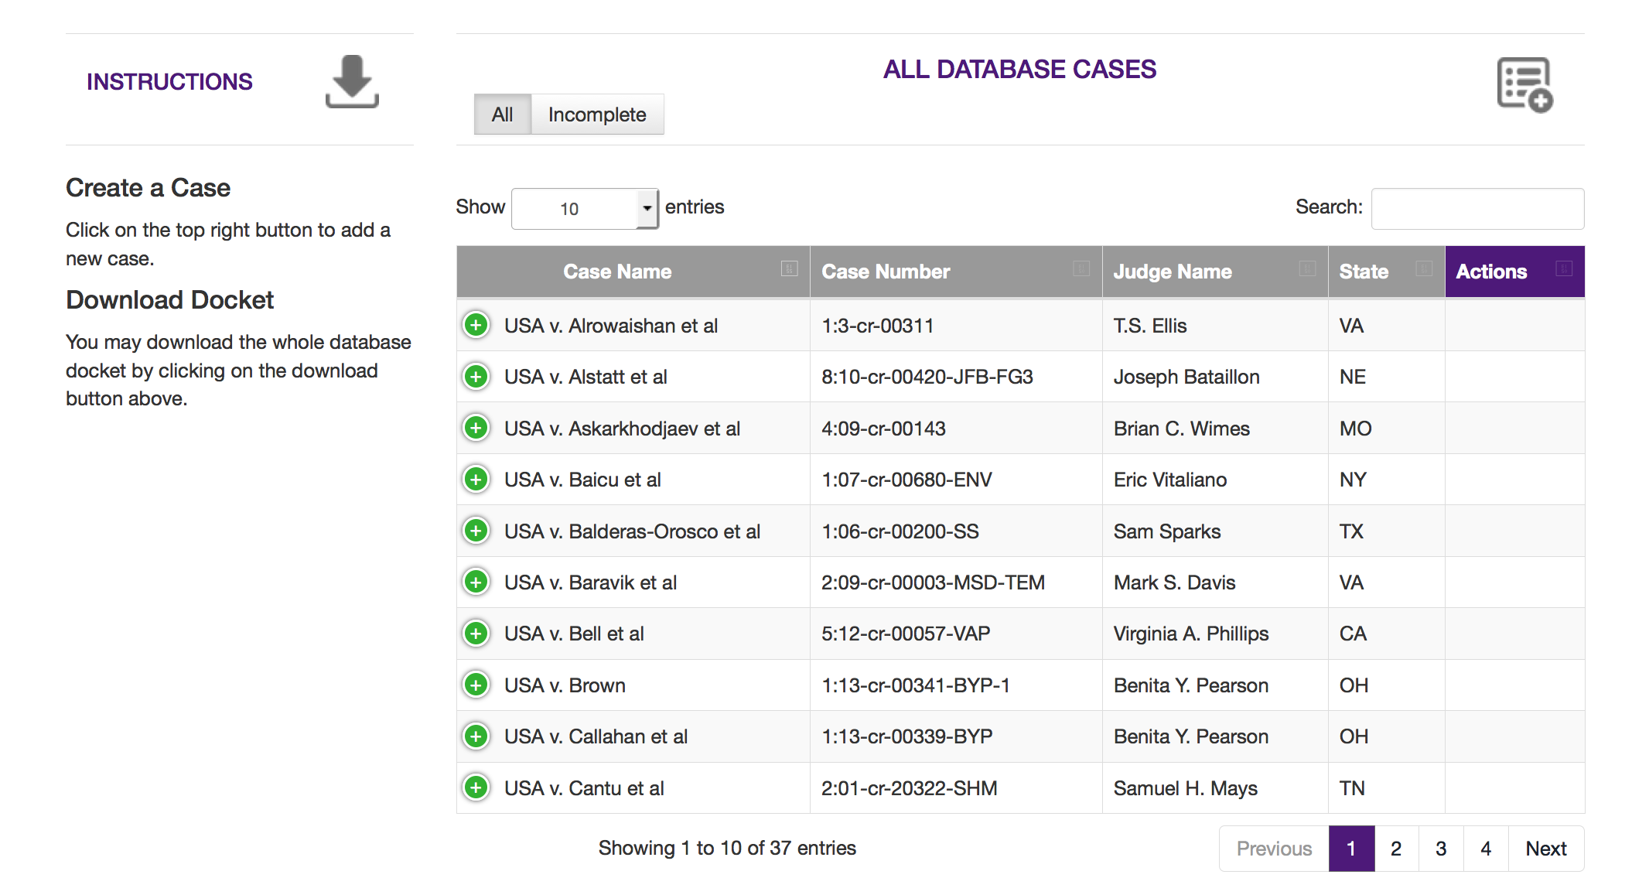
Case Creation

Slide 20
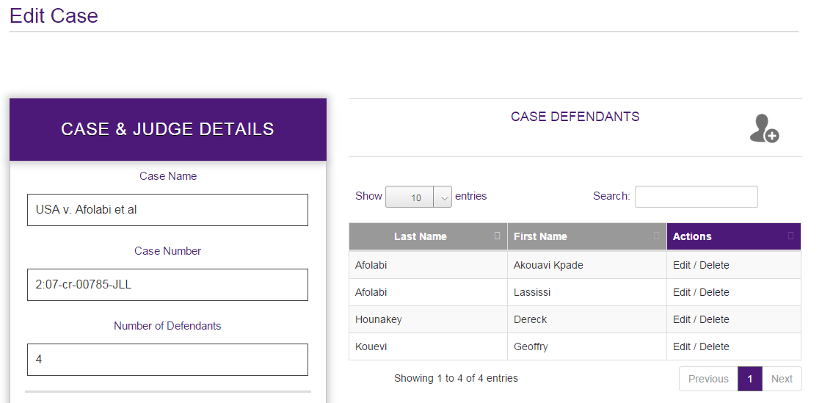
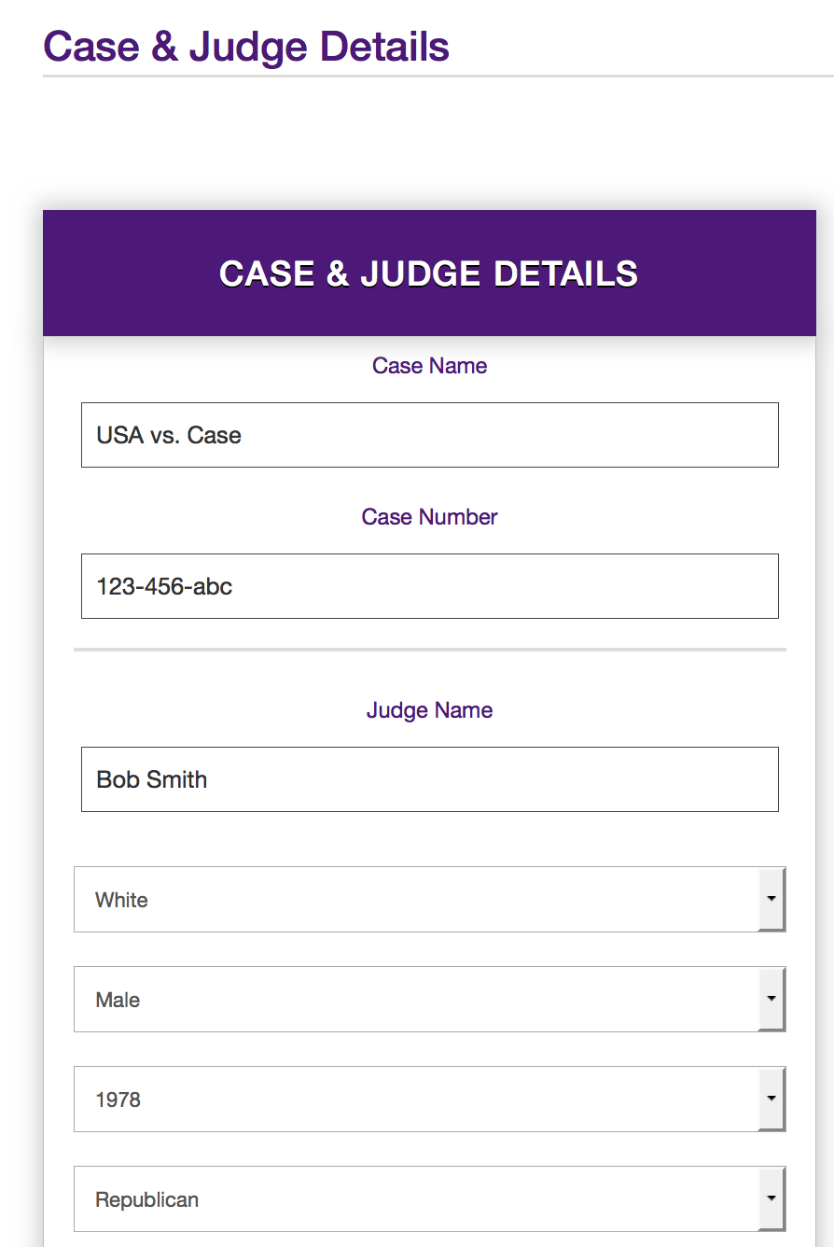
Case Creation

Slide 21
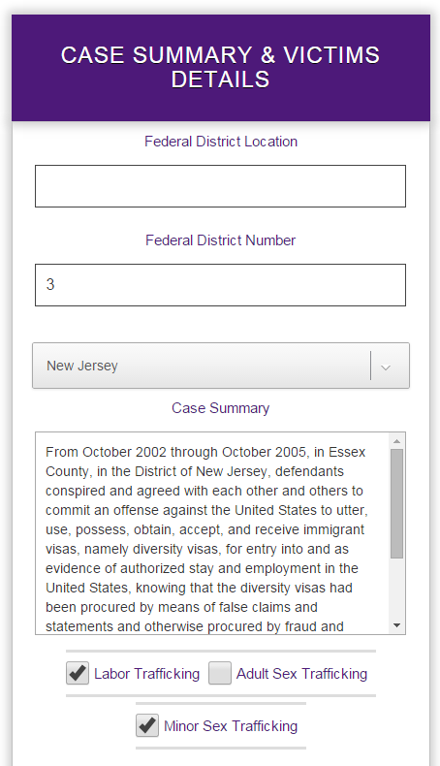
Case Creation

Slide 22
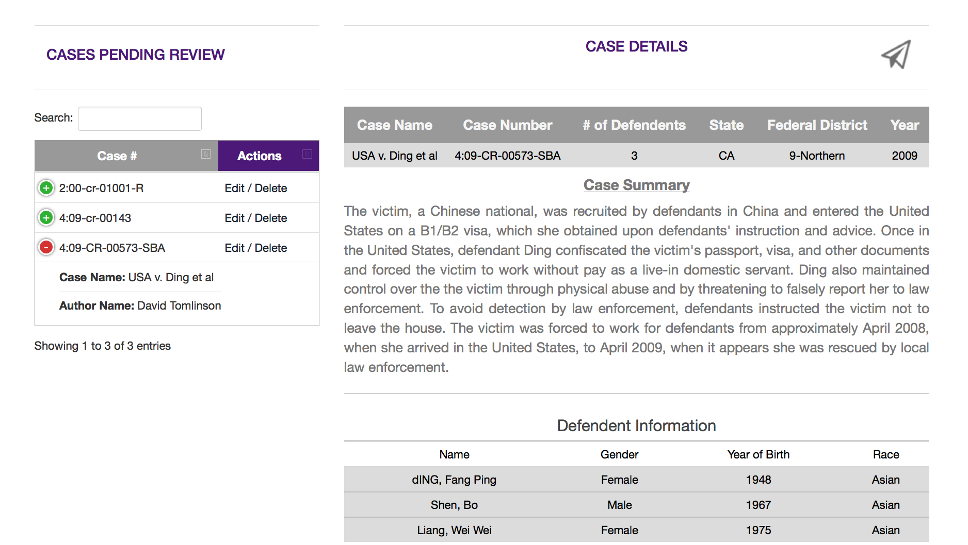
Case Review

Slide 23
Search
47 variables in 9 categories
Displays results of search in table
Each row displays modal with more details
Modal contains visible filtering function
Displays most relevant data first
Option to display all data

Slide 24
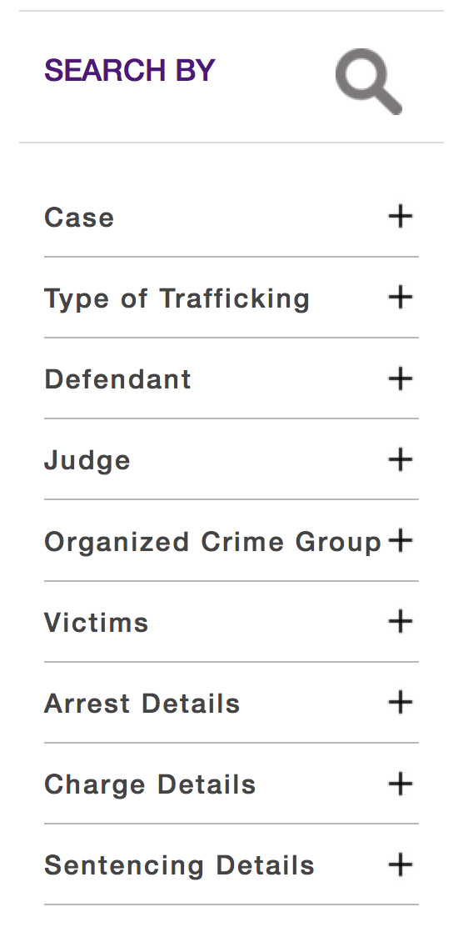
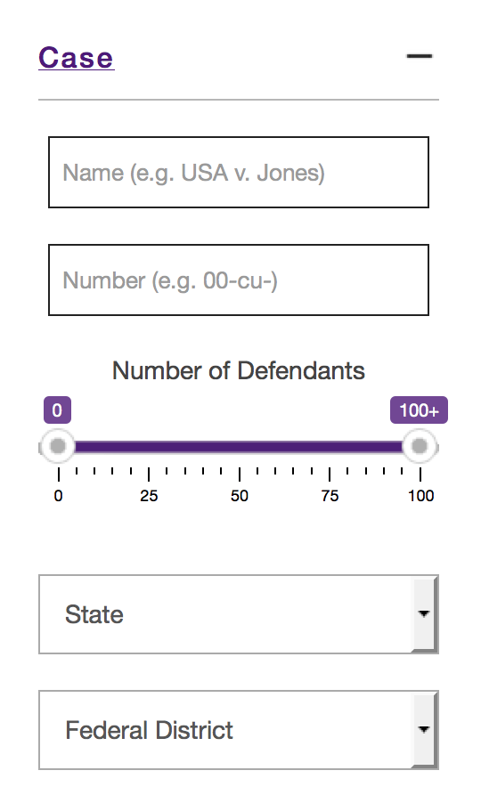
Search Criteria

Slide 25
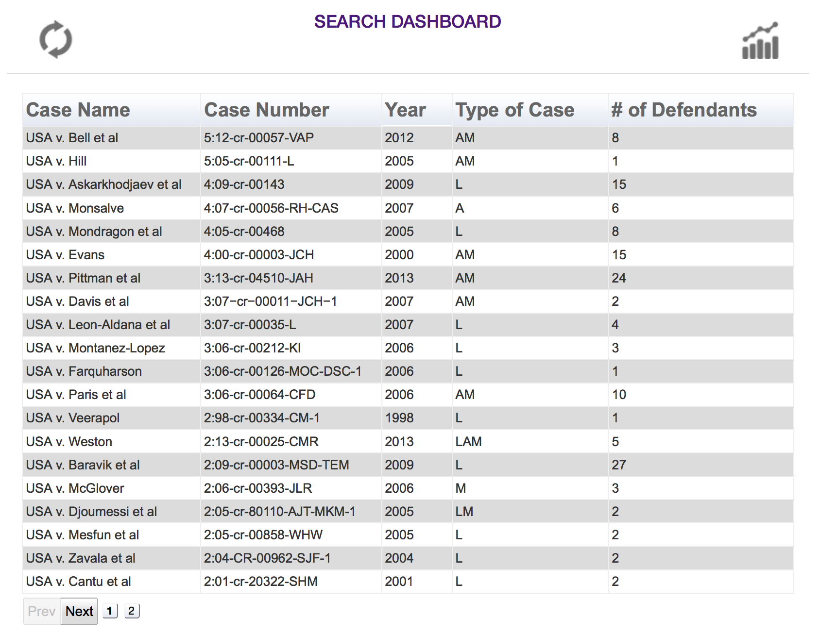
Search Results

Slide 26
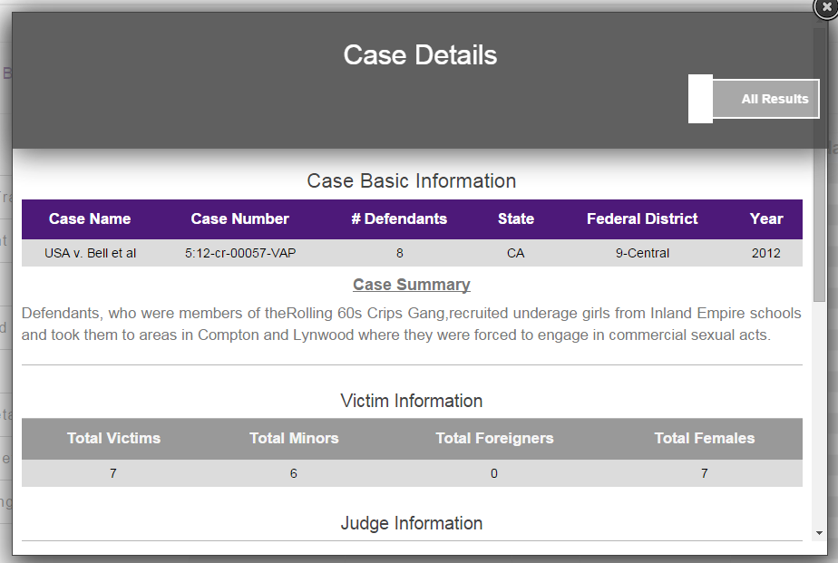
Search Results

Slide 27
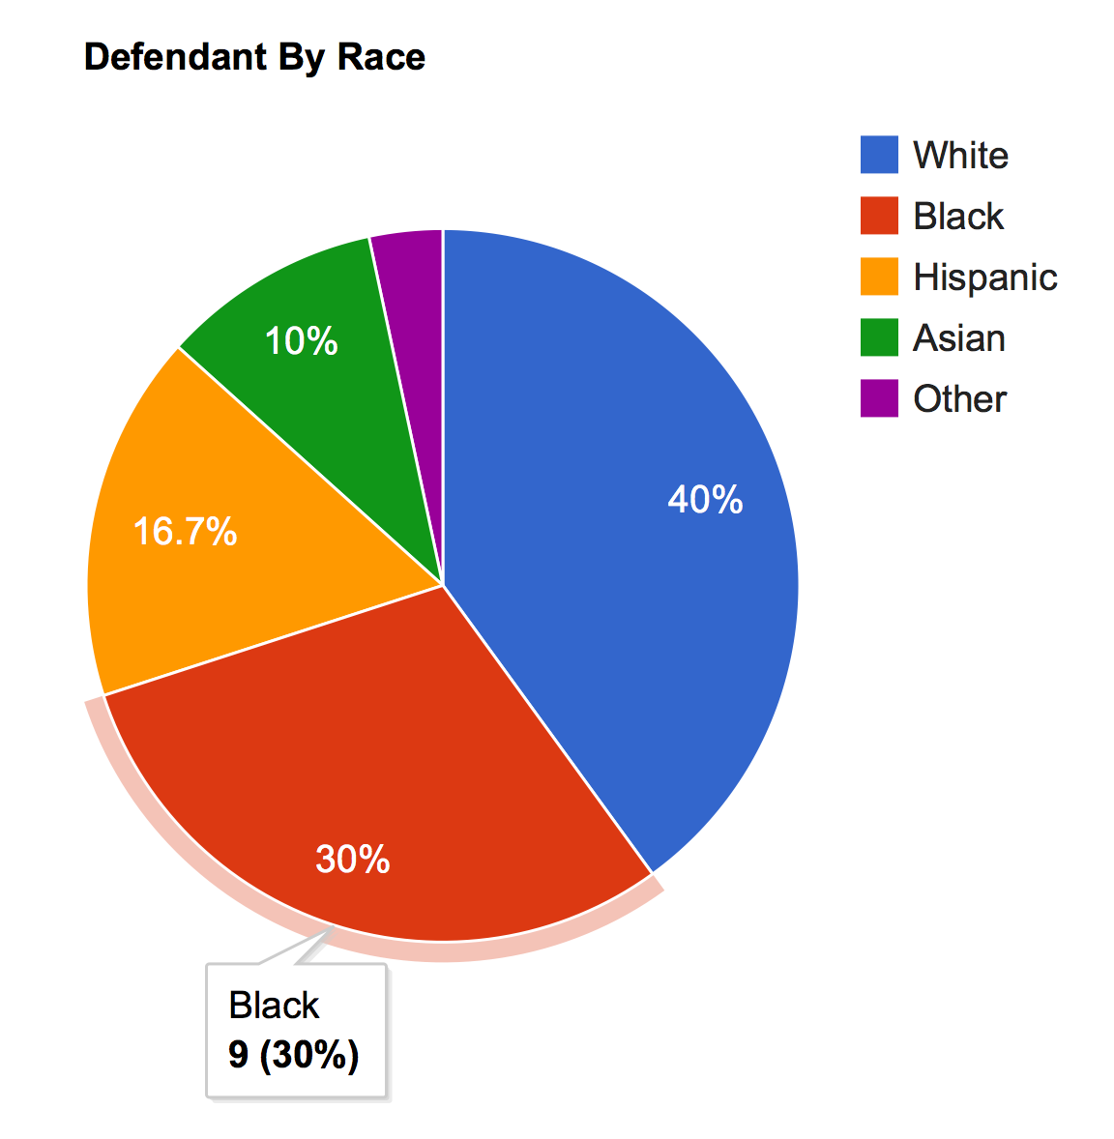
Analyze
Visualize data received from Search
5 types of graphs
Line
Bar
Histogram
Pie
Geographic
Multiple independent and dependent options

Slide 28
Demo

Slide 29
Results
Developed resource for accessing human trafficking information
Implemented dynamic graphing solution to visualize data
Provided project administrators with ability to:
Maintain dataset
Manage users

Slide 30
Challenges
Vague requirements
Clients did not know what they wanted
Team inexperience in requirements elicitation
Client Complications
Acquiring Testable Data
Difficulty in gathering data
3rd party contractor failed to deliver to client
Contained multiple errors

Slide 31
Lessons Learned
Effective communication leads to effective results
Determine stricter deadlines for clients and team
Prototype, prototype, prototype
Allocate more time for testing
Gained experience working on high-profile project

Slide 32

A Few Words From Our Client

Slide 33
Acknowledgements
Dr. Vanessa Bouché, Client
Dr. Donnell Payne, Faculty Advisor
Dr. Lisa Ball, Database Consultant

Slide 34
Questions

